Slide 1

Parent Survey Feedback
2026
Completed by 75 parents/carers -54% of all Lancaster parents/carers

Slide 2
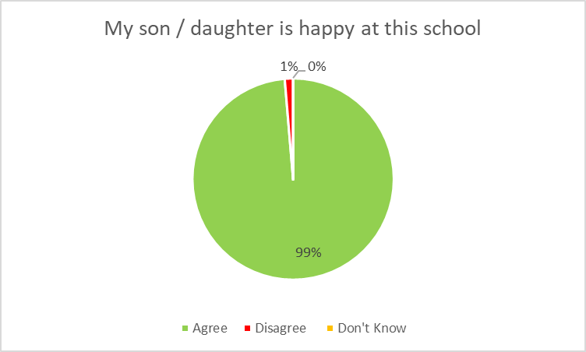

Slide 3
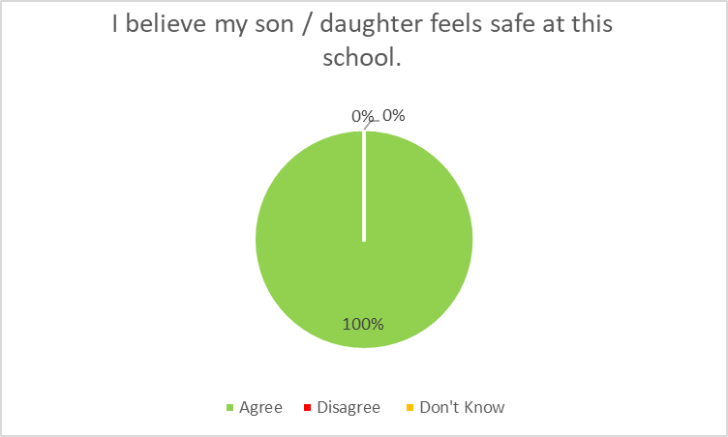

Slide 4
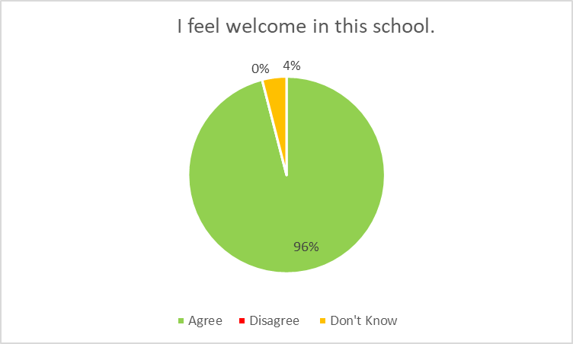

Slide 5
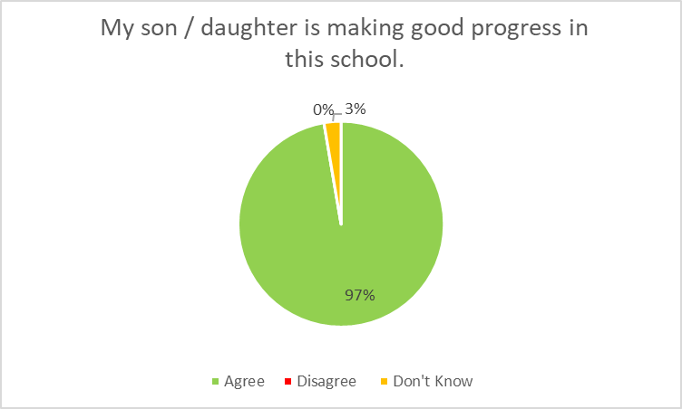

Slide 6
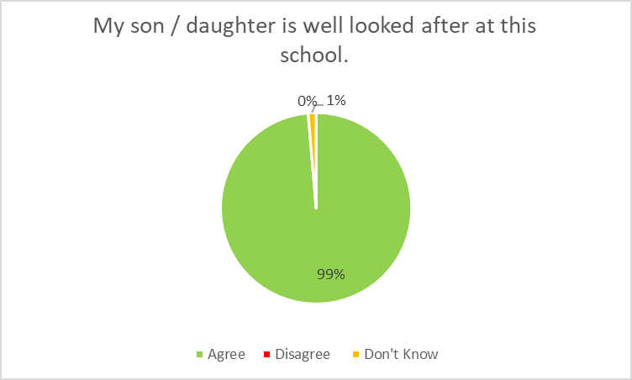

Slide 7
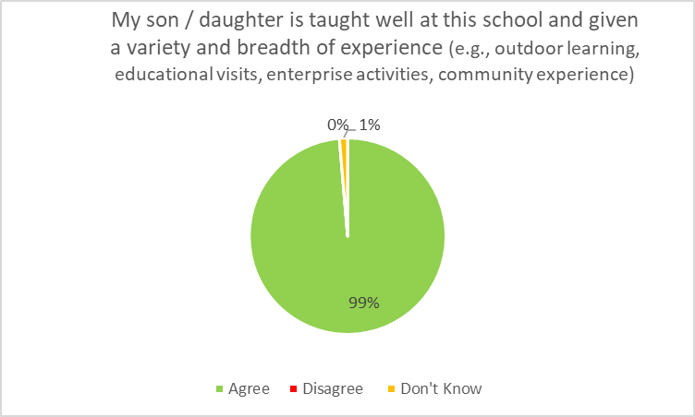

Slide 8
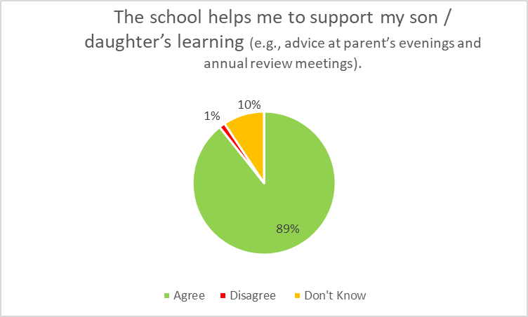

Slide 9
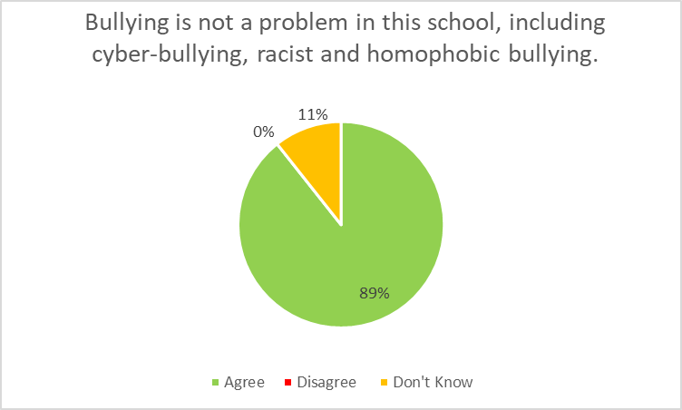

Slide 10
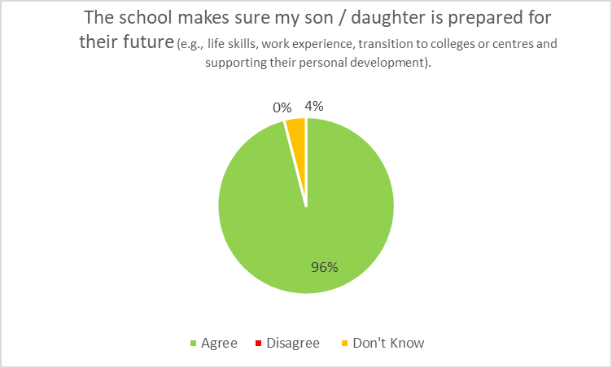

Slide 11
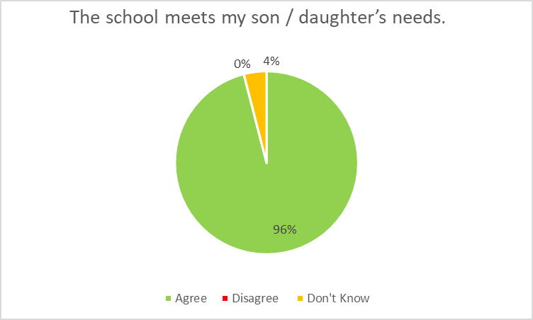

Slide 12
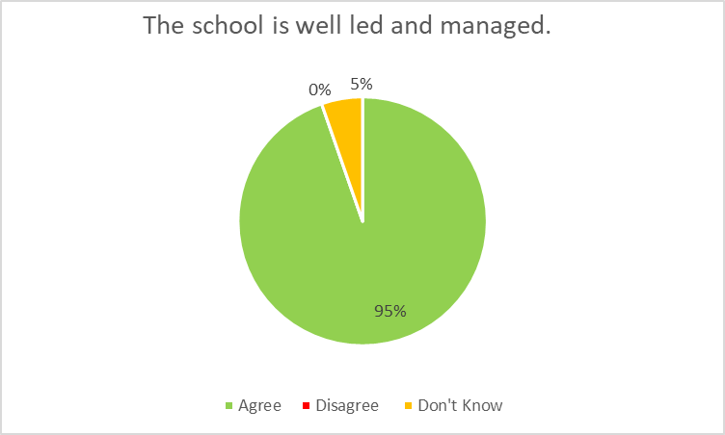

Slide 13
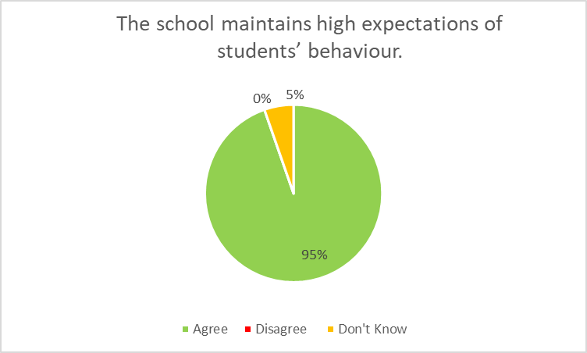

Slide 14
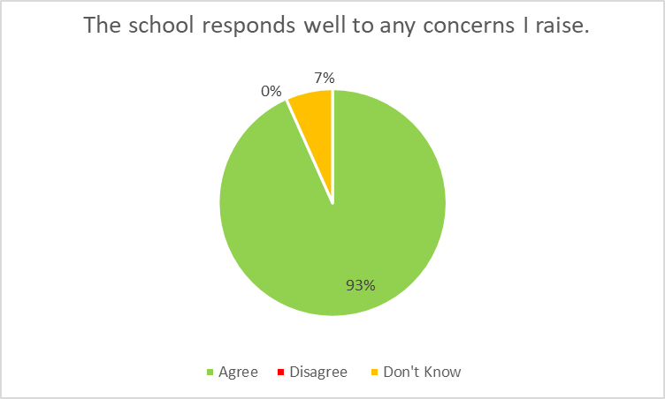

Slide 15
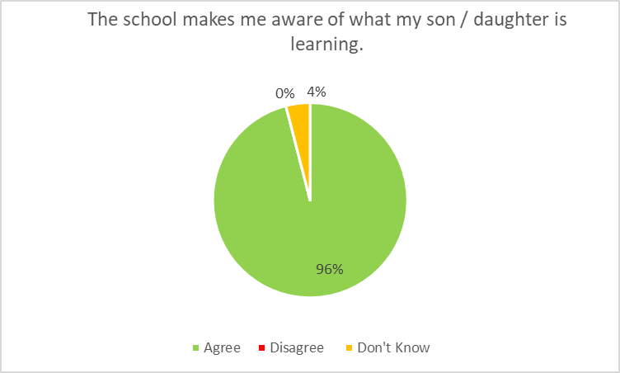

Slide 16
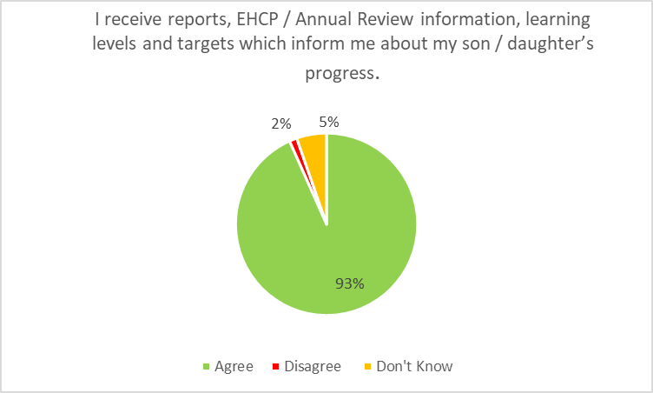

Slide 17
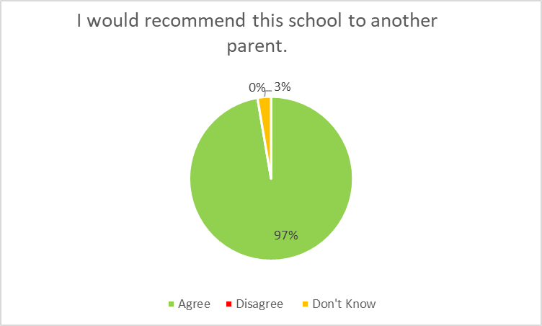

Slide 18
What the parents/carers said ....
Tom is a very caring head teacher. He and his staff go above and beyond on all levels. Wonderful school 10/10. Thank you so much all of you.
The school is very supportive
Each and every member of staff are fantastic and so helpful. Tom is a very approachable caring lead. This school, Tom and my daughters teachers and LSAs have been a God send.
Daughter is always happy to go to school & teachers are brilliant
My son enjoys all the outdoor trips and enjoys participating in all the functions organised by the school.
Jamie has blossomed since at Lancaster turning into wonderful young adult, ready for the next step in his journey
Happy with school
I am yet to have an annual review, after that I believe Lancaster school will certainly help me to support and understand my child’s learning better.
What a brilliant school! The kindness and respect from both the teachers and other students are heartwarming. Thankyou
Absolutely LOVE this school – wish we found you sooner and could stay longer. The staff in Canvey class are just amazing and we are beyond grateful to the care, support and dedication of all who work here.
Our daughter will miss Lancaster when she has to leave. She has so many varied opportunities and brilliant caring staff in her class.
Thank you for making my sons have the best future with the best staff! We appreciate you!

Slide 19
What the parents/carers said ....
This is a fantastic school for my daughter.
Breakfast clubs and extended after school clubs for working parents. Also, summer holiday clubs please if possible. Thanks.
Q.12 is tricky to answer because for neuro divergent children and young people, behaviour is communication which can include a myriad of things depending on the individual.
You guys at Lancaster School are doing a wonderful job. Keep up the good work and thank you for helping me support my child.
I am very happy with Joseph’s progress in the years he has been at Lancaster School and the quality of his overall experience. I also very much appreciate the context updates regarding daily activities via the app.
An excellent school, such a caring, nurturing environment, it makes such a huge difference to the quality of my son’s life.
Really pleased with Joshua’s start at Lancaster he is happy and obviously enjoying his time at the school which means he is developing and learning.
Would be nice to hear about whether he has had a good day in himself. Any meltdowns, different behaviours, how well he has eaten and drank.
Very happy with the standard set by the school. We have had support and advice r.e behavioural problems.

Slide 20
It is always imperative to consistently inform Parents of all elements and aspects within their Children's school day. Both positives and negatives should always be clearly communicated with Parents.
What the parents/carers said ....
To learn more basic skills for life.
I am pleased with the care and support given to my son since he joined the school in 2024/25 academic year. The headteacher and his class teachers have been great! Thank you
We feel that this school is perfect for our son and we are pleased with all of the support he receives as well as the learning opportunities he has.
I am very pleased with the support my child has been given and the communication with myself. I cannot fault anything.
Thank you
Although Holly only joined Lancaster in January we have seen a massive difference in her already. She is so much happier and her behaviour has very noticeably improved.
The staff are warm, friendly and helpful. I am yet to meet anyone who isn’t! It was meeting and talking with Tom while he showed us round that convinced my husband and I that Holly had to attend Lancaster. I absolutely believe this is the best decision we could have made (I just wish we had known about Lancaster sooner).
The activities the children do are brilliant, Holly loves everything about it, especially tennis, swimming and cafe visits!
Erin, Jess, Jo and Karina have been wonderful with Holly and I. They are a big credit to the school and we would like to thank them very much. The feedback we receive daily is very welcome and really helps us to get her talking about her day. The office staff and Leanne have also been very kind and helpful.
I have nothing but praise for the school and all the staff.
My child has come so far and I cannot think of anything more that needs to be done for further development as he is flourishing there.
Excellent school. I have every faith in the staff and my son loves coming.
Very pleased our daughter Sophie loves the school. We have found the staff to be excellent. Especially Leanne and Tom who have gone above and beyond to help us.

